Slide 1

COMP-SCI 5590 - 0001 Special Topics
Introduction To Python
A readable, dynamic, pleasant, flexible, fast and powerful language

Slide 2
Tutorial 5
Regression
Clustering
Scientific packages

Slide 3
Machine learning project
It has a number of well known steps:
Define Problem.
Prepare Data.
Evaluate Algorithms.
Improve Results.
Present Results.

Slide 4
What is SciPy?
SciPy is a library of algorithms and mathematical tools built to work
with NumPy arrays.
linear algebra - scipy.linalg
statistics - scipy.stats
optimization - scipy.optimize
sparse matrices - scipy.sparse
signal processing - scipy.signal

Slide 5
Scipy Statistics
Mean, median, mode, variance, kurtosis
Pearson correlation coefficient
Hypothesis tests (ttest, Wilcoxon signed-rank test,
Kolmogorov-Smirnov)
Gaussian kernel density estimation
See also SciKits (or scikit-learn).

Slide 6
Scipy Optimization
General purpose minimization: CG, BFGS, least-squares
Constrained minimization; non-negative least-squares
Minimize using simulated annealing
Scalar function minimization
Root finding
Check gradient function
Line search

Slide 7
What is Matplotlib?
Plotting library for Python
Works well with Numpy
Syntax similar to Matlab

Slide 8
Scatter Plot
import numpy as np
import matplotlib . pyplot as plt
x = np. linspace (0 , 10, 1000)
y = np.power(x , 2)
plt . plot (x , y)
plt .show()

Slide 9
Regression
Regression is a form of supervised machine learning,
The scientist teaches the machine by showing it features and then showing it what the correct answer is, over and over, to teach the machine.
Once the machine is taught, the scientist will usually "test" the machine on some unseen data, where the scientist still knows what the correct answer is, but the machine doesn't.
The machine's answers are compared to the known answers, and the machine's accuracy can be measured.
If the accuracy is high enough, the scientist may consider actually employing the algorithm in the real world.

Slide 10
Types
Linear Regression
Logistic Regression
Polynomial Regression
Stepwise Regression
Ridge Regression
Lasso Regression
ElasticNet Regression

Slide 11
Linear Regression
Linear regression analysis means “fitting a straight line to data” also called linear modelling
It’s a widely used technique to help model and understand real-world phenomena
• easy to use
• easy to understand intuitively
Allows prediction
we want to model our data as follows:
y = B0 + B1 * x

Slide 12
Contd.
Linear regression assumes that…
1. The relationship between X and Y is linear
2. Y is distributed normally at each value of X
3. The variance of Y at every value of X is the same (homogeneity of variances)
4. The observations are independent

Slide 14
Calculations For
Estimating The Slope (B1)
Calculate mean(X) = 3
Calculate mean(Y) = 2.8
Estimating The Intercept (B0)
1 2 3 4 5 6 | x y 1 1 2 3 4 3 3 2 5 5
Raw Data

Slide 15
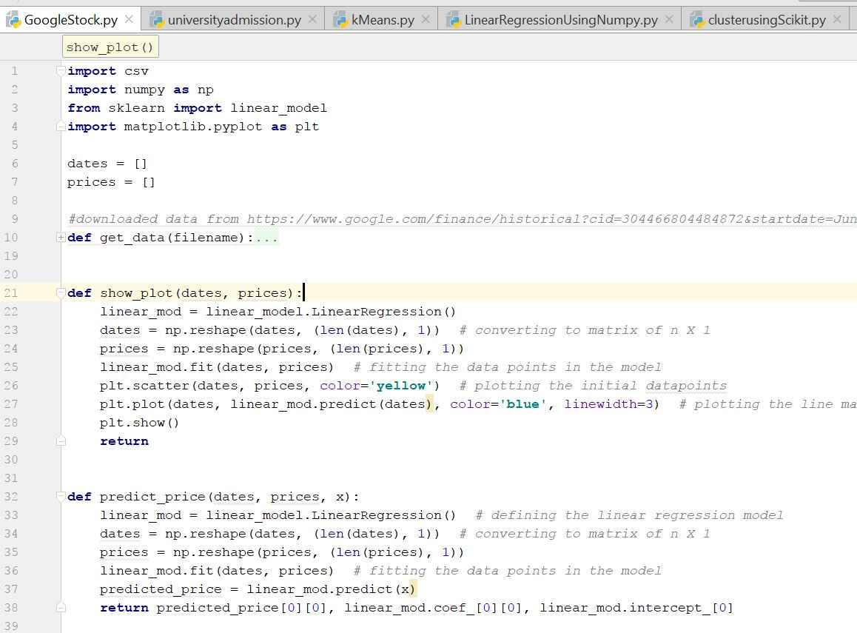
Use case 1- Stock Prediciton
Importing packages
Loading linear model
Independent variable date and dependent variable price for prediction

Slide 16
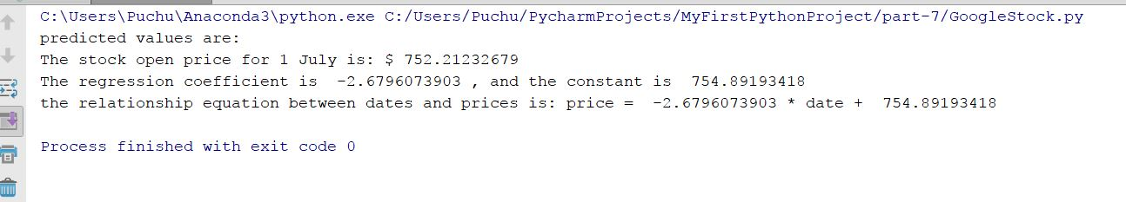
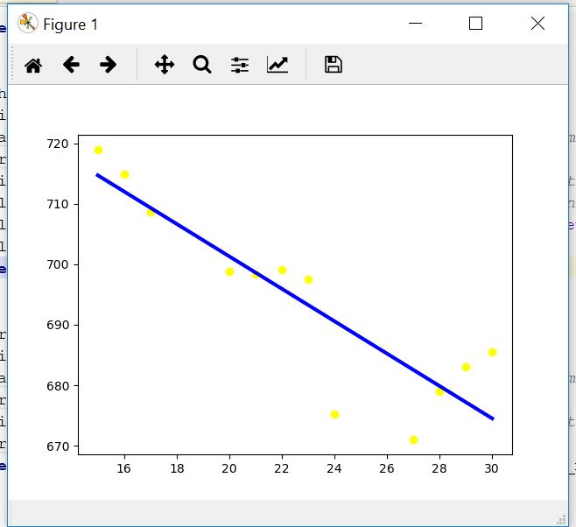
Output

Slide 17
Logistic Regression
Logistic regression is used to find the probability of event=Success and event=Failure
Logistic regression when the dependent variable is binary (0/ 1, True/ False, Yes/ No) in nature.
odds= p/ (1-p) = probability of event occurrence / probability of not event occurrence
ln(odds) = ln(p/(1-p))
logit(p) = ln(p/(1-p)) = b0+b1X1+b2X2+b3X3....+bkXk

Slide 18
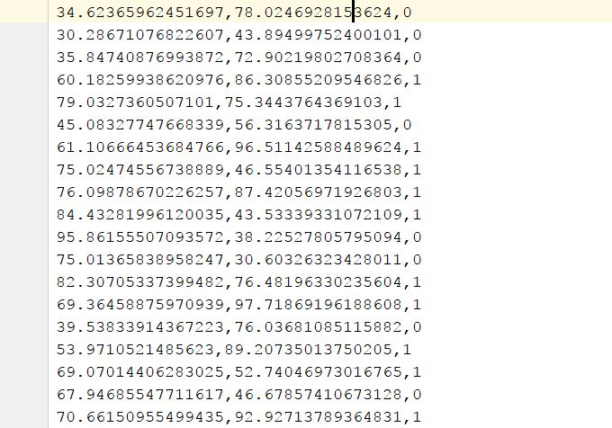
Usecase 2: university Admission
Input Data

Slide 19
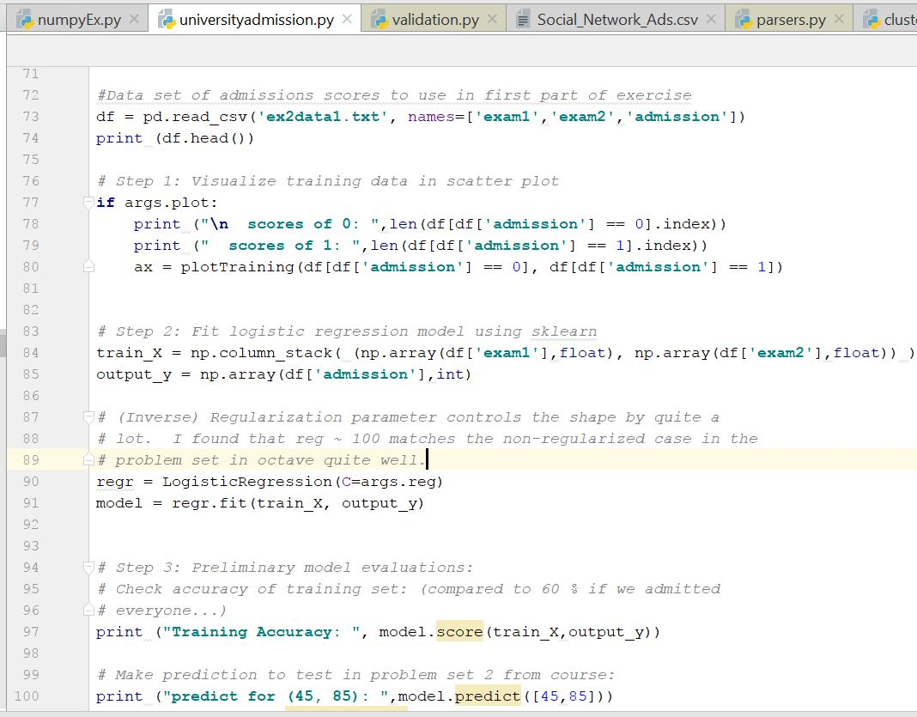
Calling Logistic Regression Model with parameters
C=1.0

Slide 20
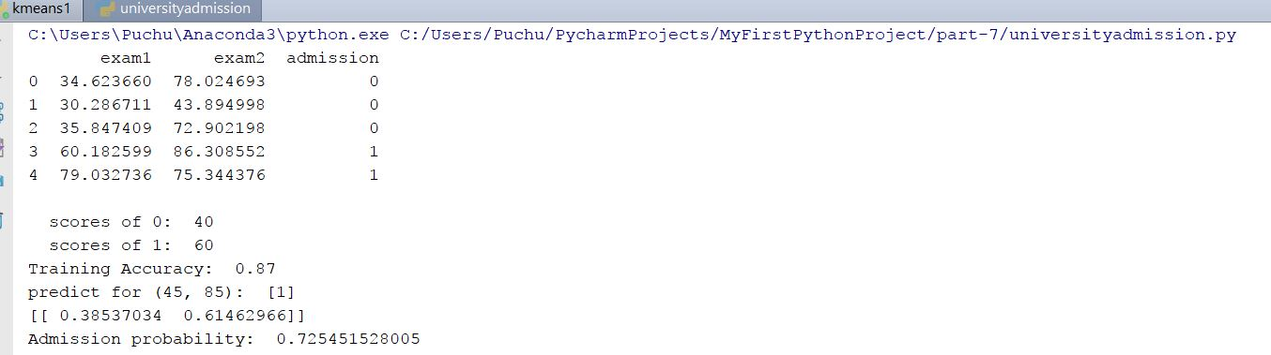
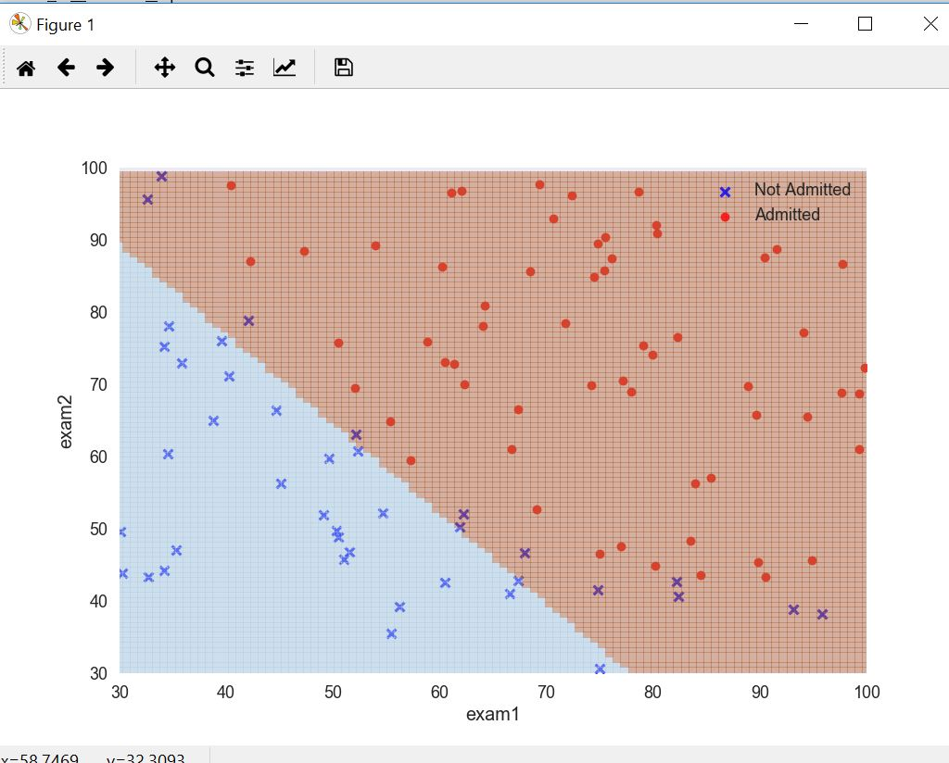
Output

Slide 21
Other Regression
Polynomial Regression: A regression equation is a polynomial regression equation if the power of independent variable is more than 1.
Stepwise Regression : form of regression is used when we deal with multiple independent variables
Ridge Regression : Ridge Regression is a technique used when the data suffers from multicollinearity ( independent variables are highly correlated).
Lasso Regression : Lasso (Least Absolute Shrinkage and Selection Operator) also penalizes the absolute size of the regression coefficients
y=a+b*x^2

Slide 22
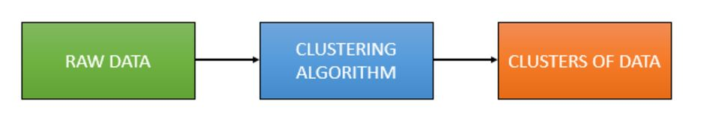
Clustering
Clustering is the grouping of objects together so that objects belonging in the same group (cluster) are more similar to each other than those in other groups (clusters)

Slide 23
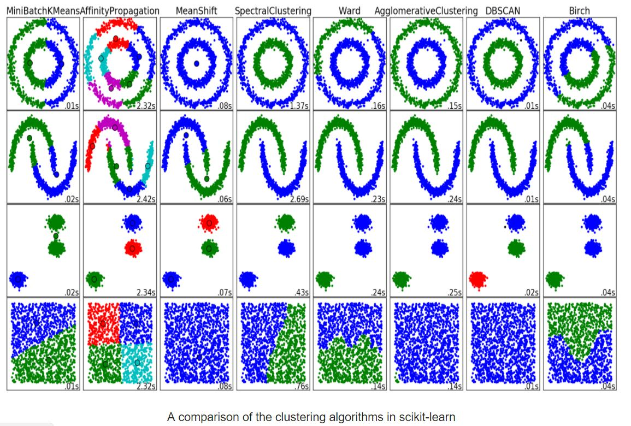
Comparison of various Clustering

Slide 24
Contd.
Method name | Parameters | Scalability | Usecase | Geometry (metric used)
K-Means | number of clusters | Very large n_samples, medium n_clusterswith MiniBatch code | General-purpose, even cluster size, flat geometry, not too many clusters | Distances between points
Affinity propagation | damping, sample preference | Not scalable with n_samples | Many clusters, uneven cluster size, non-flat geometry | Graph distance (e.g. nearest-neighbor graph)
Mean-shift | bandwidth | Not scalable with n_samples | Many clusters, uneven cluster size, non-flat geometry | Distances between points
Spectral clustering | number of clusters | Medium n_samples, small n_clusters | Few clusters, even cluster size, non-flat geometry | Graph distance (e.g. nearest-neighbor graph)
Ward hierarchical clustering | number of clusters | Large n_samples and n_clusters | Many clusters, possibly connectivity constraints | Distances between points
Agglomerative clustering | number of clusters, linkage type, distance | Large n_samples and n_clusters | Many clusters, possibly connectivity constraints, non Euclidean distances | Any pairwise distance
DBSCAN | neighborhood size | Very large n_samples, medium n_clusters | Non-flat geometry, uneven cluster sizes | Distances between nearest points
Gaussian mixtures | many | Not scalable | Flat geometry, good for density estimation | Mahalanobis distances to centers
Birch | branching factor, threshold, optional global clusterer. | Large n_clustersand n_samples | Large dataset, outlier removal, data reduction. | Euclidean distance between points

Slide 25
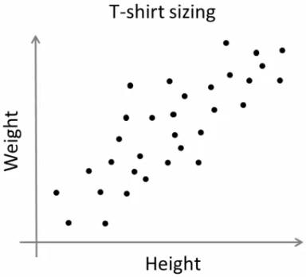
K-Means
T-shirt size problem
Consider a company, which is going to release a new model of T-shirt to market.
Obviously they will have to manufacture models in different sizes to satisfy people of all sizes.
So the company make a data of people’s height and weight, and plot them on to a graph.
Company can’t create t-shirts with all the sizes. Instead, they divide people to Small, Medium and Large, and manufacture only these 3 models which will fit into all the people.

Slide 26
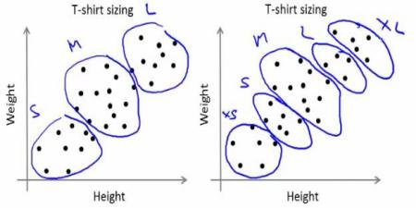
Solution
Do clustering
Clustering is Iterative Process
Algorithm:
Select initial centroids (randomly)
Calculate distance of each data point to each centroid. It can be done in many ways.
The one with the minimum distance between data point and initial centroids will be selected.
Calculate the average of all the initial clusters and then the new centroids will be adjusted to new clusters.
Repeat the above process to N iterations

Slide 27
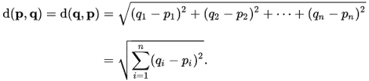
Example
Suppose, D2, D5 & D7 are chosen as initial centroids
Distance formula to calculate minimum distance from initial centroids and the do clustering

Slide 28
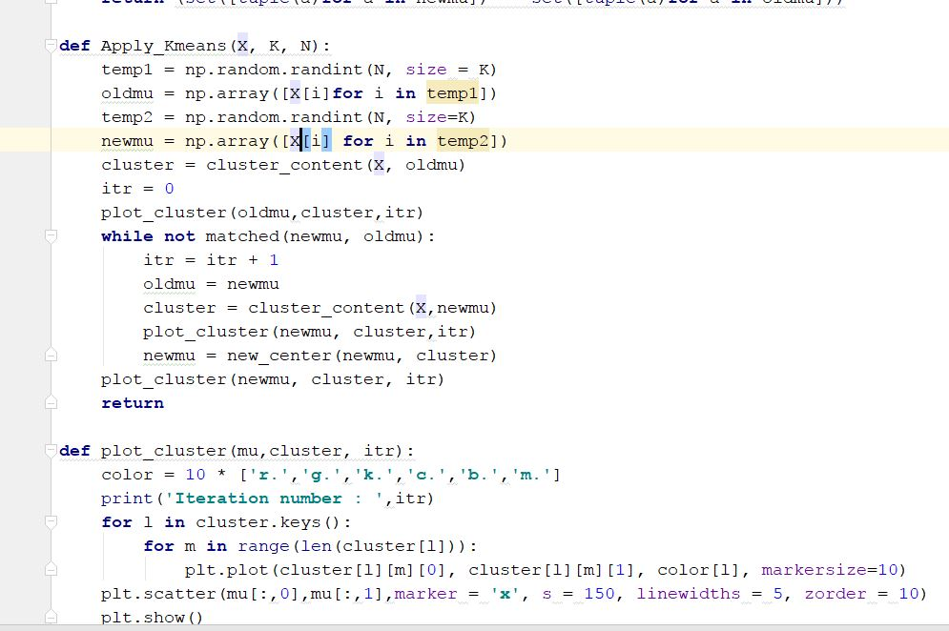
Usecase 3: kMean
K Mean algorithm

Slide 29
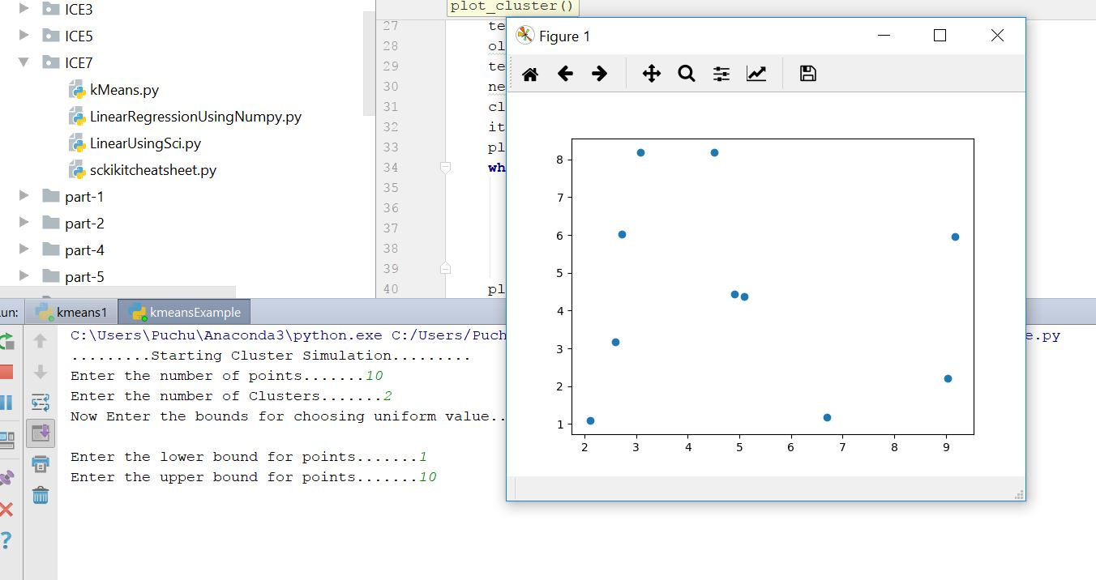
Output
Initial datapoints

Slide 30
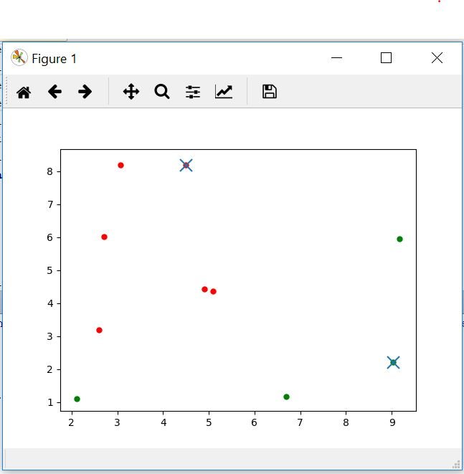
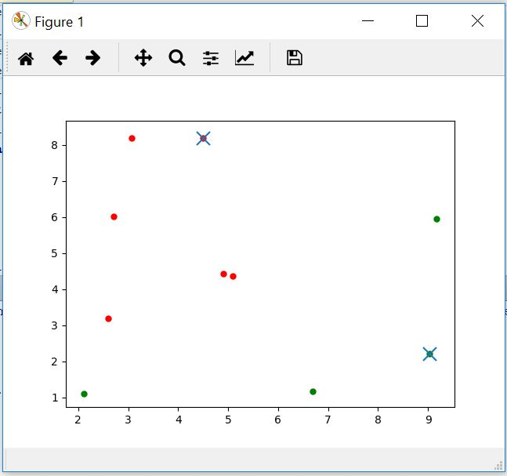
Different Iterations

Slide 31
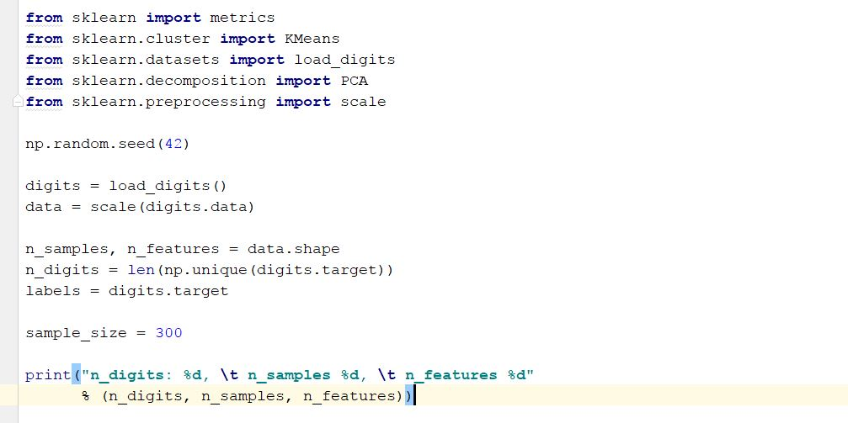
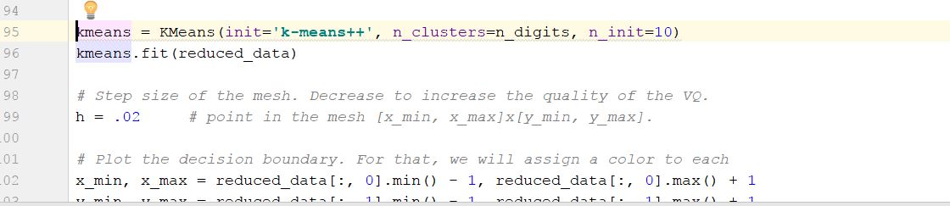
Use case 4- Clustering using sklearn
Loading digits Data from sklearn
Calling kMeans model

Slide 32
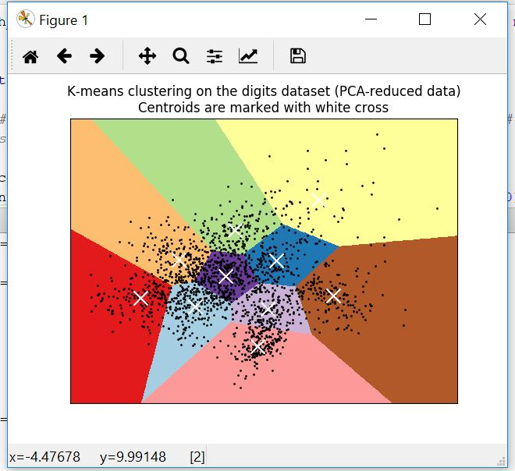
Output

Slide 33
Other Popular Libraries for Python
Tensorflow
Theano
Pylearn2
PyEvolve
NuPIC
http://stackabuse.com/the-best-machine-learning-libraries-in-python/

Slide 34
Datasets Different Categories
stock trading
video games
astronomy
sports betting
flight time prediction
Also updated in Class sheet in datasets Tab

Slide 35
References
https://web.stanford.edu/~schmit/cme193/lec/lec5.pdf
http://machinelearningmastery.com/machine-learning-in-python-step-by-step/
http://scikit-learn.org/stable/auto_examples/linear_model/plot_ols.html
https://www.analyticsvidhya.com/blog/2015/08/comprehensive-guide-regression/
http://scikit-learn.org/stable/modules/clustering.html
http://scikit-learn.org/stable/auto_examples/cluster/plot_kmeans_digits.html
http://www.kdnuggets.com/2015/11/seven-steps-machine-learning-python.html/2
http://beancoder.com/linear-regression-stock-prediction/
http://opencv-python-tutroals.readthedocs.io/en/latest/py_tutorials/py_ml/py_kmeans/py_kmeans_understanding/py_kmeans_understanding.html
https://github.com/tarlen5/coursera_ml/blob/master/unit6/ex2_sklearn

Slide 36
In Class Exercise
Create linear regression model for the following table using numpy only.
Plot the model using matplotlib.
Hints: You need to calculate the mean of X , Y using numpy
and then calculate the regression coefficients.
X | Y
0 | 1
1 | 3
2 | 2
3 | 5
4 | 7
5 | 8
6 | 8
7 | 9
8 | 10
9 | 12

Slide 37
In Class Exercise
2) Solve T Shirt size problem as illustrated in class using k means clustering method.

Slide 38
Assignment Submission
Submit Assignment on Github with source code and create wiki page
https://goo.gl/forms/cxvY8Kg1pvNNzrpw1
Submit the code part to UMKC blackboard Turnitin
Remember similarity score should be less than 45%
Submit your screenshots as well.

